Slide 1
Discussion Unit: DSE Analytics, Always-On SQL (AOS)
Discussed briefly, enabled in DSE Studio Discussion Unit 6210/6211
One (two ?) settings in dse.yaml,
alwayson_sql_options:
enabled: true
More settings, more function
Notes:
The goal of this Discussion Unit is to detail DSE Analytics Always-On SQL (AOS).

Slide 2
Discussion Lab:
DSE Analytics; Spark/SQL, SQL (thus far)
Discuss-
Notes:
On the next page we enter a Discussion Lab.

Slide 3
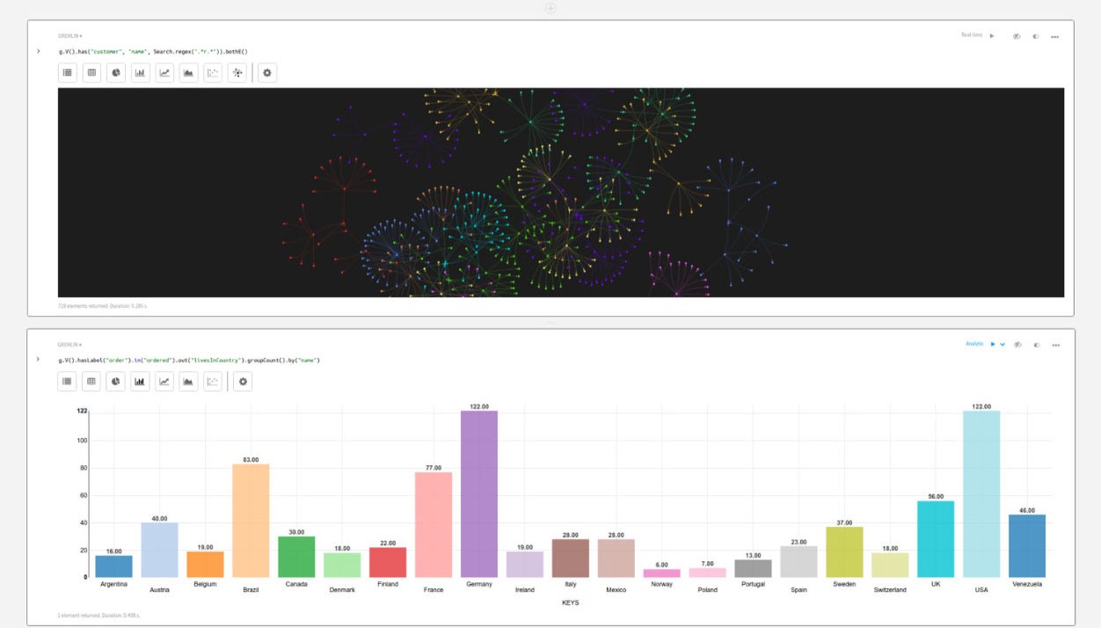
DSE Analytics: Spark SQL
Using "dse spark-sql"; How was your statement executed ? (Did you see an (n) step progress bar ?)
What was your fastest return time ?
What was happening that took a good portion of that time ?
Was DSE Studio SQL faster ?
Notes:
Discuss the questions above-

Slide 4
End of Discussion Lab:
Notes:
End of Discussion Lab-

Slide 5
DSE Always-On SQL (AOS):
dse.yaml,
alwayson_sql_options: # Change T|F requires node restart
enabled: true
dse client-tool alwayson-sql start|stop|status|restart|reconfig
Example,
dse client-tool alwayson-sql status // Also host:9077
dse client-tool alwayson-sql stop
dse client-tool alwayson-sql start
dse client-tool alwayson-sql --dc dc-west start
dse client-tool alwayson-sql reconfig
Notes:
Relative to DSE Analytics Always-On SQL, the following is offered:
Enabling AOS (when it was not enabled at boot time), requires a node restart.
AOS, like DSE Analytics, is enabled DC by DC.
A given host, (reported by status), is elected the 'connection point' (CP); made transparent by the DSE driver. This (CP) host supports a minor status page on port 9077.
Reference Urls,
https://docs.datastax.com/en/dse/6.0/dse-admin/datastax_enterprise/tools/dseClientTool/dseClientToolcommands/dseClient-toolAlwayson-sql.html

Slide 6

DSE Always-On SQL: reconfig
dse.yaml
reserve_port_wait_time_ms
alwayson_sql_status_check_wait_time_mas
log_dsefs_dir
runtime_max_errors
spark/conf/spark-alwayson-sql.con
50 lines, mostly security
Notes:
Configuring AOS:
AOS must start with the DSE node, else a nod restart is required.
Pre-requisites; DSEFS enabled, native_transport_address set/reachable, more. See Url below.
Minimally, the (n) settings listed under dse.yaml, may be set via reconfig, full multi-user mode.
Refrence Urls,
https://docs.datastax.com/en/dse/6.0/dse-dev/datastax_enterprise/spark/alwaysOnSql.html
https://www.datastax.com/2018/05/introducing-alwayson-sql-for-dse-analytics

Slide 7
DSE Always-On SQL: What/Why-
Per analytics DC
Aimed at BI tools; Tableau, others
Offers a JDBC/ODBC like interface for that reason
And DSE Studio
Pre-instantiated resource, performance
Notes:
The what and why of DSE Always-On SQL-
Aimed at BI tool, and Studio.
(Simpler clients) not requiring the full power of Spark/SQL/other.

Slide 8


DSE Always-On SQL: Has evolved with Spark
> 2014
Shark, SharkServer
-- Hive, Read HiveQL
-- Read Hadoop formats
-- M/R job atop Spark
2015
Catalyst
-- Tree Manipulation FW
-- Spark streaming
-- Graphframes
-- Enable predicate pushdown
-- Support for TPC/DS
Jobs on Spark FW (RDD, ..)
Notes:
2015 and the Catalyst optimizer to Spark opened a lot of optimizations; huge launch. With Catalyst, Spark/SQL can support most of the TPC/DS (SQL data warehouse suite).

Slide 9
DSE Always-On SQL: Recent
DSE 5.1 used Spark ThriftServer (HiveServer2)
Spark Thrift Server, not related to past DSE Thrift
DSE 6.0
HA, Node in DC elected to be connection point (CP), failure, new election
Driver transparently knows CP
SQL syntax, cached to DSEFS (shared)
Incremental collect()
Uses native CQL comm protocol; async, and server notifications
Must read Url on Notes page-
Thrift, Spark Thrift Server
thrift.apache.org
Fast/lightweight means to deliver RPC interface
Security incompleteness; runs as single app, single user token (id)
(No) H/A
-- No agent auto restart
-- Data not cached w/ new
agent
Single, long running app
-- No sharing w/ other
apps, no shared
SparkContext
Notes:
DSE 6.0 delivers Always-On SQL, comments:
An enhancement over Spark ThriftServer
Uses a native DSE communication protocol; asynchronous operations, futures (server notifications)
Similar to DSE Analytics; driver automatically handles migrating host
Reference Urls,
Must read,
http://www.russellspitzer.com/2017/05/19/Spark-Sql-Thriftserver/
https://www.youtube.com/watch?v=_qo-0cqRSjU
CQL native communication protocol,
https://www.datastax.com/dev/blog/binary-protocol

Slide 10
DSE Always-On SQL: SQL commands
spark-sql> cache table ks_7579.customer;
// Time taken: 10.445 seconds
spark-sql>cache table as select customer_num from ks_7579.customer;
// Time taken: 1.239 seconds
spark-sql> uncache table ks_7579.customer;
// Time taken: 0.158 seconds
spark-sql> clear cache;
// Time taken: 0.004 seconds
Sugar for df.cache
-- DSEFS or local disk as configured
Notes:
Performance optimization using Always-On SQL, available as Spark/SQL. Using RDDs/DFs/Datasets, these optimizations are available via programming, but harder than SQL.

Slide 11
DSE Always-On SQL: SQL commands
spark-sql> select count(*) from ks_7579.customer;
// 28
// Time taken: 9.78 seconds, Fetched 1 row(s)
spark-sql> insert into ks_7579.customer2 select * from ks_7579.customer;
// Time taken: 2.934 seconds
spark-sql> select count(*) from ks_7579.customer2;
// 28
// Time taken: 0.546 seconds, Fetched 1 row(s)
Notes:
Most SQL commands are available. Here a table copy is displayed.

Slide 12
DSE Always-On SQL: SQL commands, Explain
spark-sql> explain select count(*) from ks_7579.customer;
== Physical Plan ==
*HashAggregate(keys=[], functions=[count(1)])
+- Exchange SinglePartition
+- *HashAggregate(keys=[], functions=[partial_count(1)])
+- *Scan org.apache.spark.sql.cassandra.CassandraSourceRelation
ks_7579.customer[] ReadSchema: struct<>
Time taken: 0.156 seconds, Fetched 1 row(s)
Notes:
Most SQL commands are available. Explain plan generation.

Slide 13
End of Unit:
Notes:
End of Discussion Unit-

